Slide 1
Social Media Sentiment Analysis and Opinion Mining (Elections 2016)
July 27, 2016
Nupoor Paneliya (1501756)
Chinmay Modi (1509628)

Slide 2
Outline
Problem Definition
Mining Process
Data Collection
Prepare Training Dataset
Data Preprocessing
Building Classification model
Classifier Performance
Results
Similar Classifier & Accuracy

Slide 3
Problem Definition
Mine Twitter data and predict upcoming 2016 USA presidential elections.
Why Twitter?
Digital democracy is here
We no longer watch our leaders on television and register our opinion on Election Day
Modern politics happens when somebody comments on Twitter.
310 million active users worldwide
65 million active users in USA

Slide 4
Mining Process
Collect twitter data in JSON format.
Clean up the collected data and integrate into a database. This involves removing useless tags and attributes, and tokenizing the data in a usable format.
Data normalization by converting textual tweet data into score values. This involves parsing the database from step 2 and converting the data.
Parse the data with the classifier and obtain useful information and patterns.

Slide 5
Data Collection
Gather a list of important keywords and hash tags related to upcoming elections.
Used Twitter Streaming API which return relevant tweets in JSON format which makes it easy to parse in a Python script.
Collected tweets contains many unnecessary fields which are not require for this mining. So we fetch the needed fields and store it in MySQL database.
Python code that extract tweets and store it in database is here.
Tweets collected: 143020

Slide 6
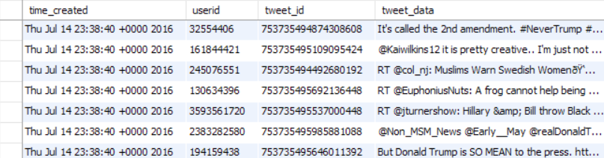
Final Data after Collection

Slide 7
Prepare Training Dataset
After gathering relevant and needed data, we create training set by manually rating some tweets.
Tweets rated: 350
Rate 1 for Hillary and 2 for Trump, make it +ve for positive tweets and –ve for negative tweets.
Python code that does this rating is here.

Slide 8
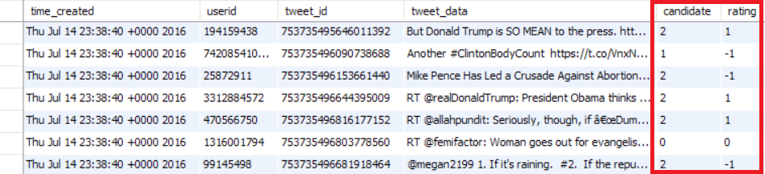
Training Dataset

Slide 9
Data Preprocessing: Tweets Tokenization
We need content of the tweets which is embedded in text.
To start our analysis we need to break the text down into words.
Purpose of tokenization is to split a stream of text into smaller units called tokens, usually words or phrases.
Python code that tokenize the tweets is here.
Each word is given positive or negative rating and counter is maintained to count its frequency.

Slide 10
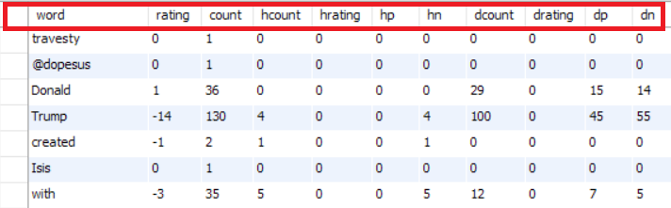
Tokenized Data

Slide 11
Classification Modeling
The classification method we use is based on text based alignment analysis i.e. predicting what a textual data is about, based on ratings of individual words or tokens.
Each word has an impact of a neutral rating, as well as applying to both candidates. We can then determine which candidate the tweet is about, as well as whether it is positive or negative, based on the word composition in the tweet.
The algorithm is incremental, just like naïve Bayesian Classifier. Tweets are rated if they have at least 60% of their words already classified. This allows us to rate words that are missing from the DB, on the fly. Thus, the classifier has an increasing accuracy as it analyzes more and more tweet data.

Slide 12
Classifier Performance
Non Incremental: between 60% to 70%

Slide 13
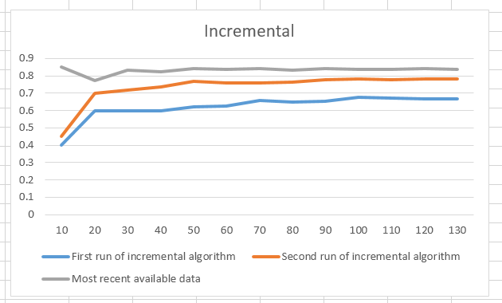
Classifier Performance
Incremental:
Round 1 – 66%
Round 2 – 78%
Round 3 – 83%

Slide 14
Results
The tweets show two main results
First, the support for Hillary is usually subdued, and tends to hover around smaller absolute values. In contrast, the opinion on Donald Trump is very polarized, with most tweets about him having high absolute scores.
Second, Hillary’s support has gone down significantly in the time period of our data collection. At the beginning of our project, when Bernie was still in the race, Hillary had significantly more positive ratings, and held a lead over Trump. But after Bernie bowed out of the race, and after DNC leaks were revealed by WikiLeaks, Hillary’s support has gone down a lot, to the point of falling below Trump.

Slide 15
Results
Our results are consistent with the media portrayal of the candidates, including the trends of support for both.
If this data is an indicator of the elections, we can predict that while Trump is a lot more controversial than Hillary, he may still win the election solely based on the absolute amount of negativity Hillary generates.

Slide 16
Similar Classifier and Accuracy
http://www.laurentluce.com/posts/twitter-sentiment-analysis-using-python-and-nltk/
Accuracy is 0.8 with handpicked tweets on generic data
http://cs.stanford.edu/people/alecmgo/papers/TwitterDistantSupervision09.pdf
0.65 with Natural language processing with keywords based analysis
0.8 with Bayes
http://crowdsourcing-class.org/assignments/downloads/pak-paroubek.pdf
0.6 - 0.8 based on method of analysis

Slide 17
Similar Classifier and Accuracy
http://www.cs.columbia.edu/~julia/papers/Agarwaletal11.pdf
60.83 is highest accuracy of multiple methods
http://blog.datumbox.com/how-to-build-your-own-twitter-sentiment-analysis-tool/
83.26 highest accuracy
https://arxiv.org/ftp/arxiv/papers/1509/1509.04219.pdf
Approx. 80% accuracy
http://www.aclweb.org/anthology/W13-1106
58.96% highest accuracy with a combination of tools

Slide 18
Future Work
Improve accuracy of classifier, by using better word analysis techniques, more focus on word position in sentence, bigrams and trigrams as well as phrases.
Improve parameters of classifier for better accuracy.

Slide 19
Thank You!!!

